Slide 1

Event-by-event flow from ATLAS
Jiangyong Jia

Slide 2

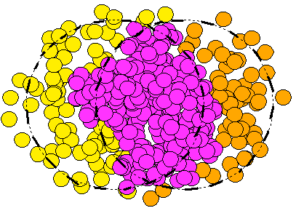


Initial geometry & momentum anisotropy
hydrodynamics
by MADAI.us
Single particle distribution
Pair distribution
Momentum anisotropy probes:
initial geometry and transport properties of the QGP

Slide 3
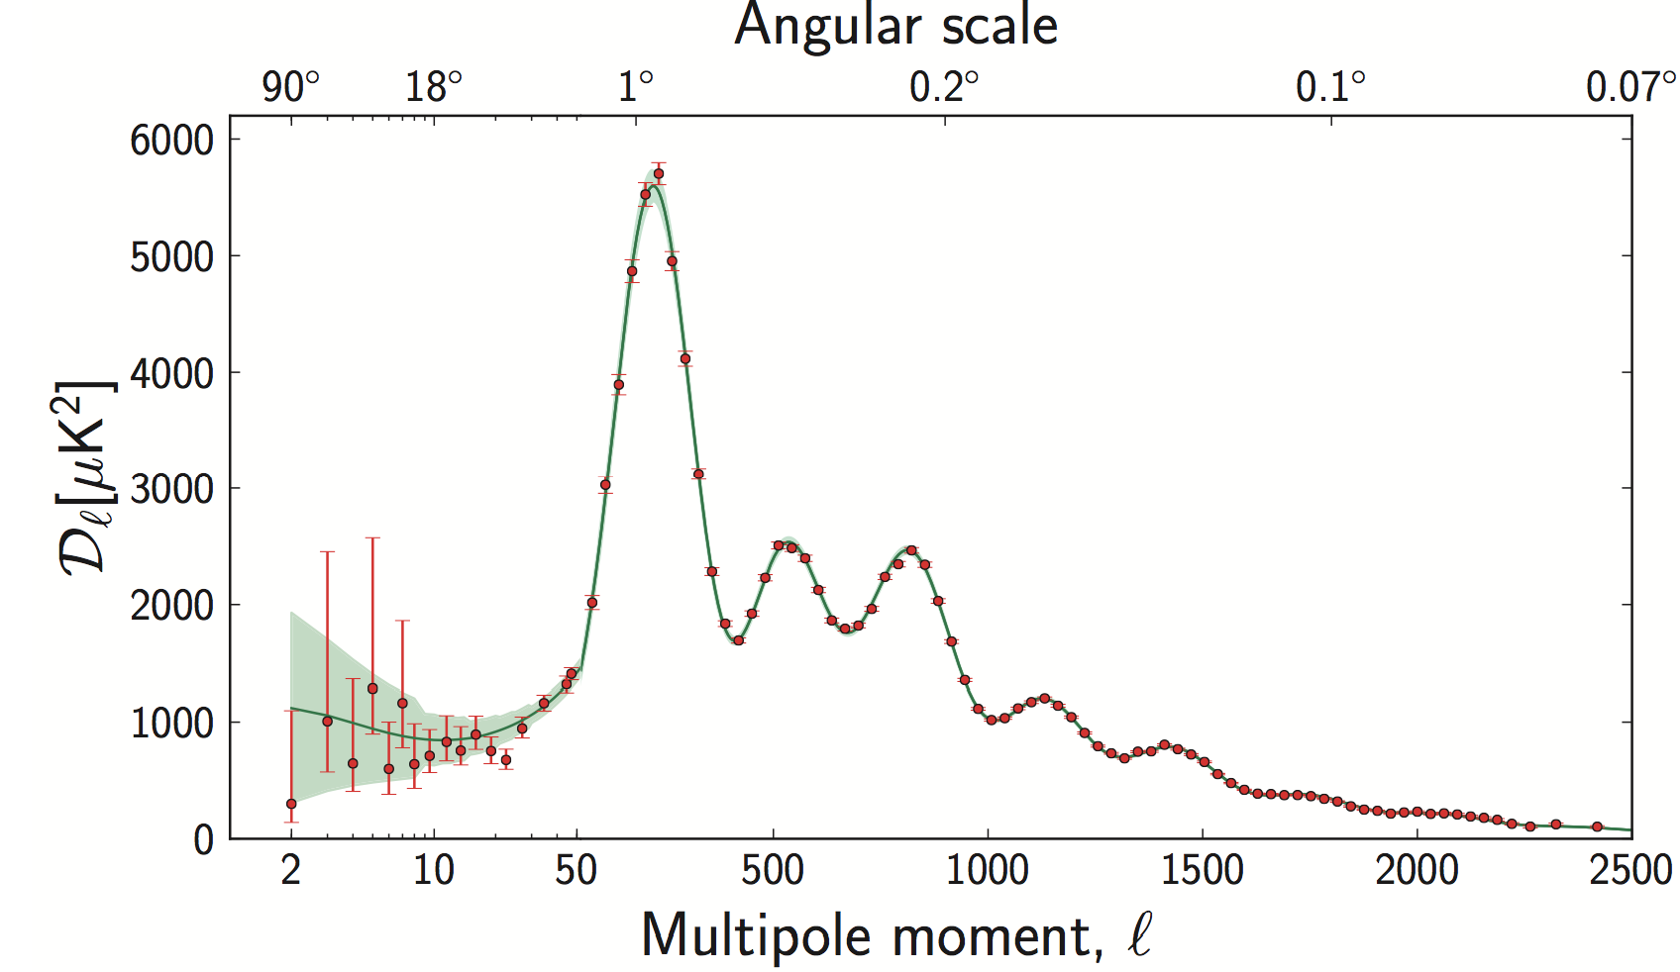
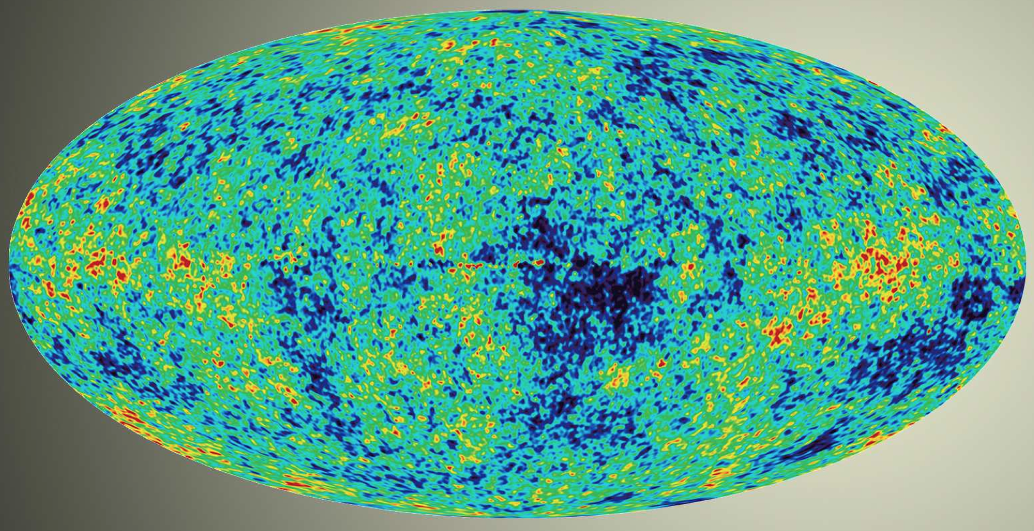
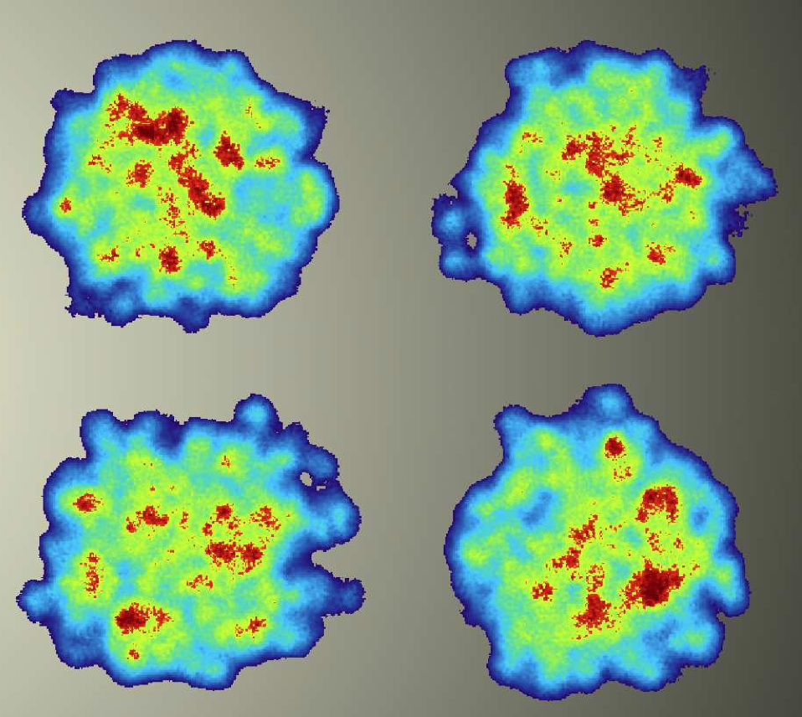
Anisotropy power spectra
One big-bang event
Big-bang CMB temperature power spectra
Little bang
momentum power spectra
Many little-bang events
Many little-bang events→
probability distributions: p(v_{n},v_{m},….,Φ_{n},Φ_{m}…..)

Slide 4
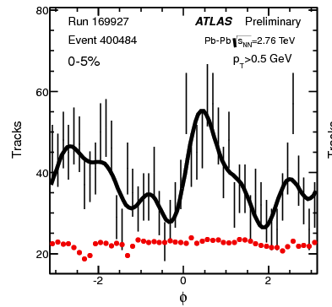
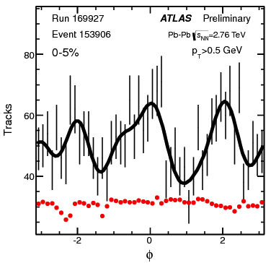
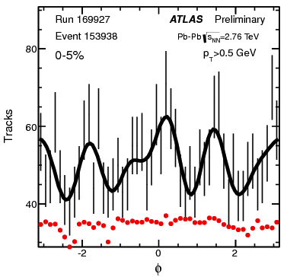
Event by event fluctuation seen in data

Slide 5
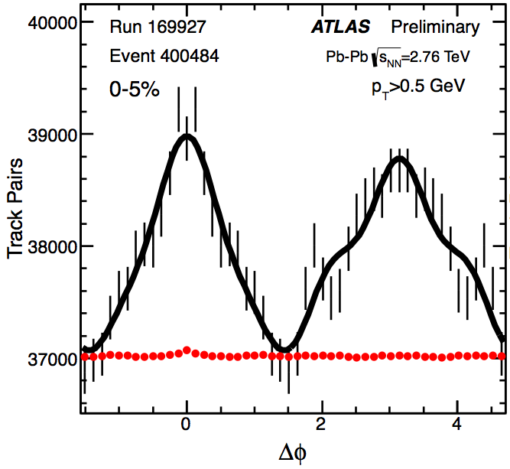
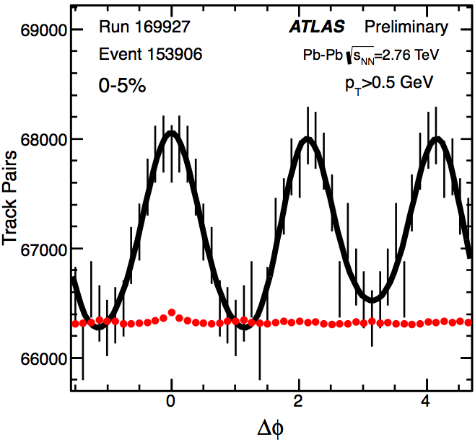
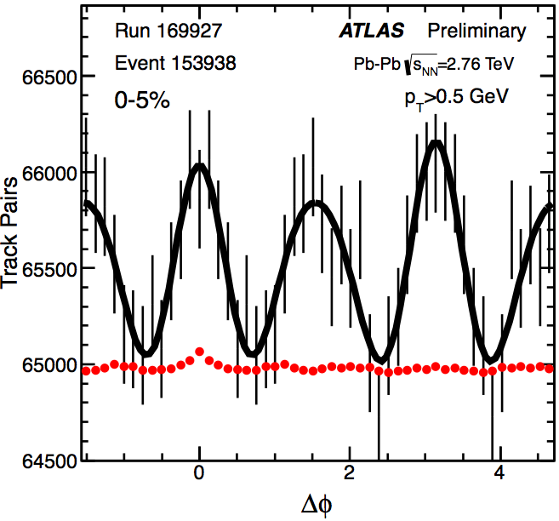
Event by event fluctuation seen in data
Rich event-by-event patterns for v_{n} and Φ_{n}!

Slide 6
Outline
p(v_{n},v_{m},….,Φ_{n},Φ_{m}…..)
Event-plane correlations → p(Φ_{n},Φ_{m}…..)
Event-by-event v_{n} distributions→ p(v_{n})
  Also influence of nonflow via simulation
ATLAS-CONF-2012-49
1305.2942

Slide 7
p(Φ_{n},Φ_{m}…..)
Correlation can exist in the initial geometry and also generated during hydro evolution
The correlation quantified via correlators
Corrected by resolution
Generalize to multi-plane correlations
Φ₂
Φ₃
Φ₄
^{arXiv:1205.3585}
^{arXiv:1203.5095}
Glauber
Bhalerao et.al.

Slide 8
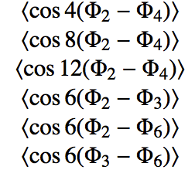
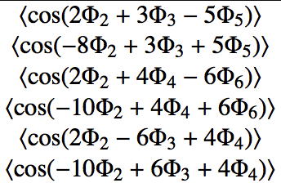
A list of measured correlators
List of two-plane correlators
List of three-plane correlators
“2-3-5”
“2-4-6”
Reflects correlation of two Φ_{n} relative to the third
“2-3-4”

Slide 9
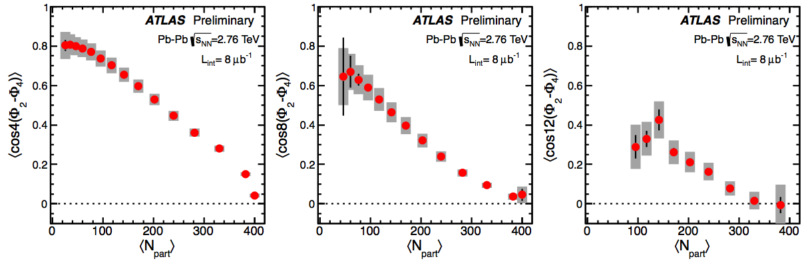
Two-plane correlations

Slide 10
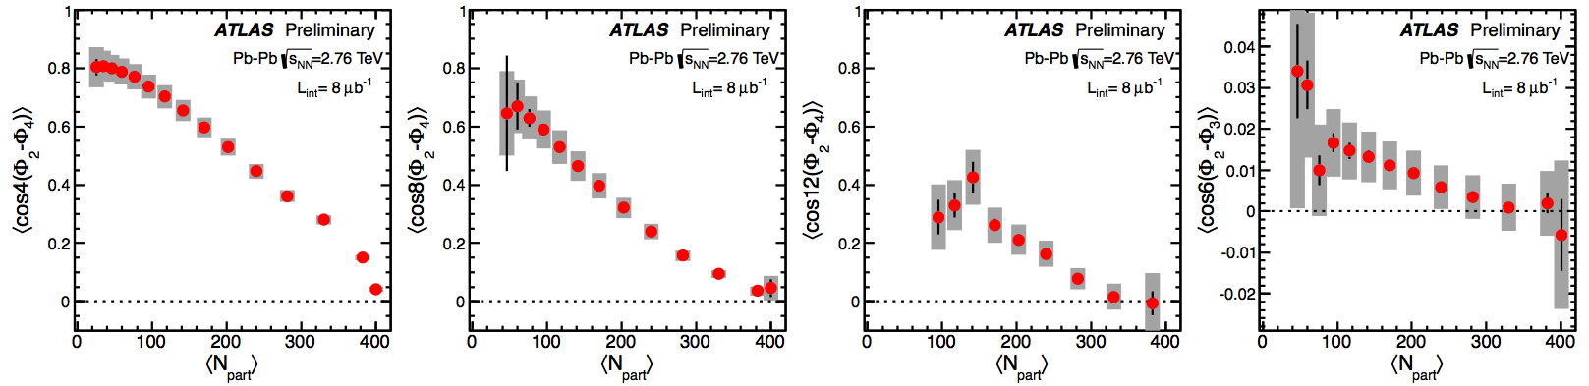
Two-plane correlations

Slide 11
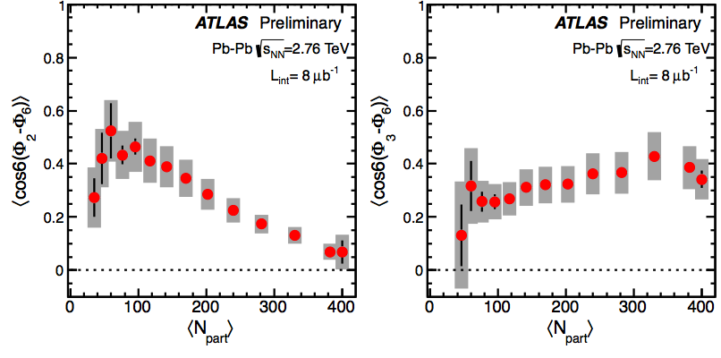
Two-plane correlations
Teaney & Yan
Rich patterns for the centrality dependence

Slide 12
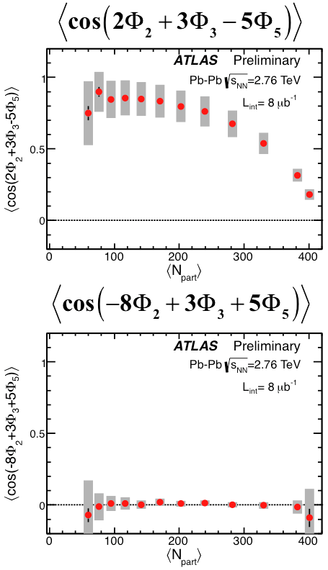
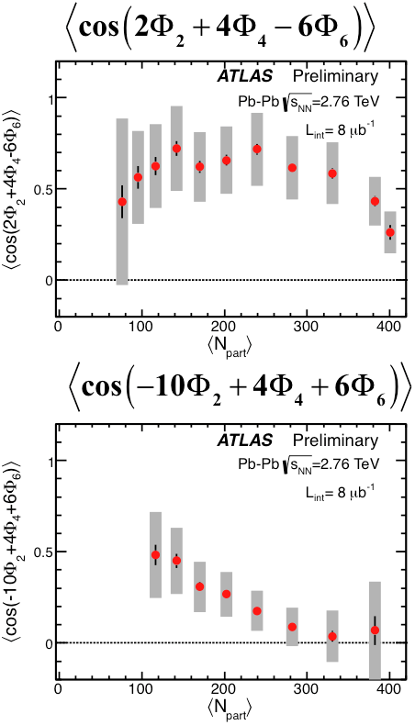
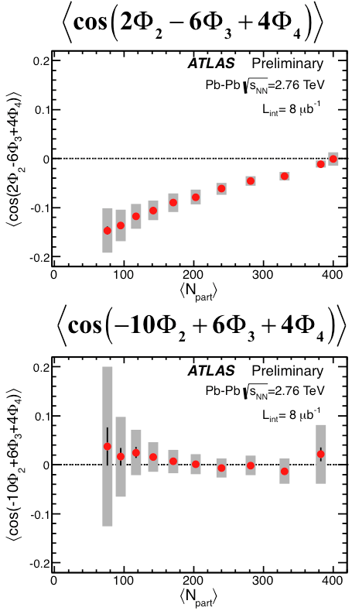
Three-plane correlations
“2-3-5” correlation
“2-4-6” correlation
“2-3-4” correlation
Rich patterns for the centrality dependence

Slide 13



Compare with EbE hydro calculation: 2-plane
Initial geometry
+ hydrodynamic
Zhe & Heinz
geometry only
EbyE hydro qualitatively reproduce features in the data

Slide 14
Compare with EbE hydro calculation: 3-plane
Initial geometry
+ hydrodynamic
Zhe & Heinz
geometry only
N_{part}
Over-constraining the transport properties

Slide 15
Event-by-event v_{n} distributions

Slide 16
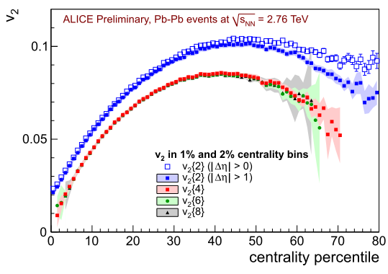
Gaussian model of v_{n} fluctuations
Flow vector
Multi-particle cumulants in Gaussian fluctuation limit
Various estimators of the fluctuations:
Gaussian model
arXiv: 0708.0800
arXiv:0809.2949
Bessel-Gaussian function
=
=
=
∞
1
=0.52

Slide 17
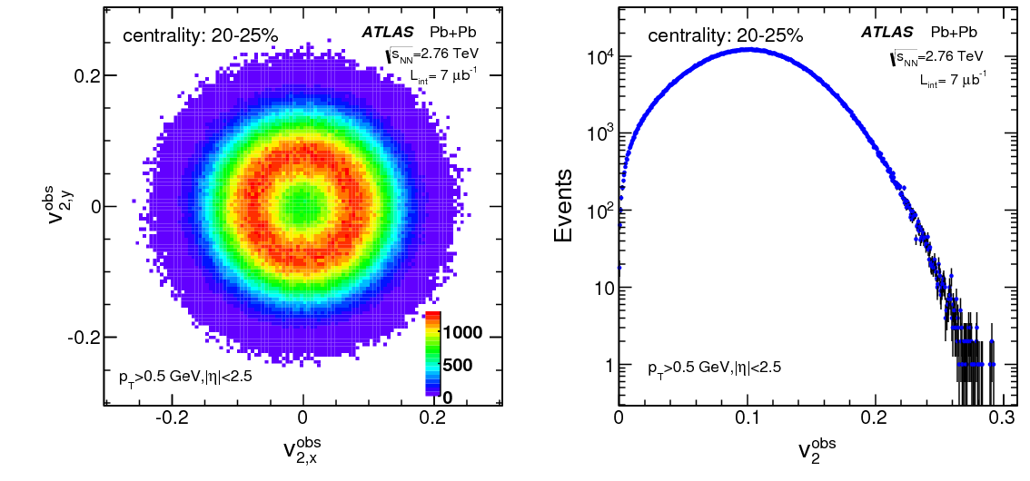

Flow vector and smearing
=
?
The key of unfolding is response function:

Slide 18
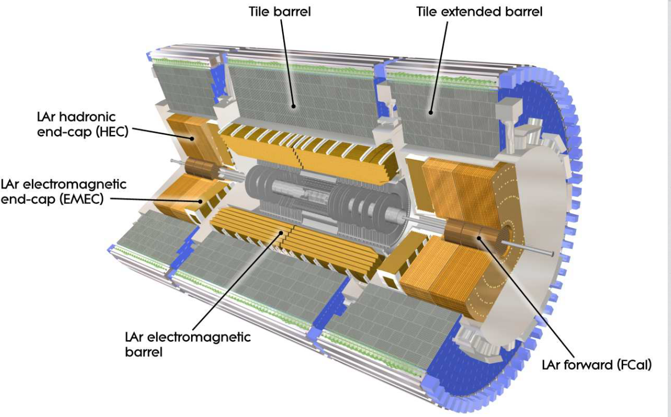
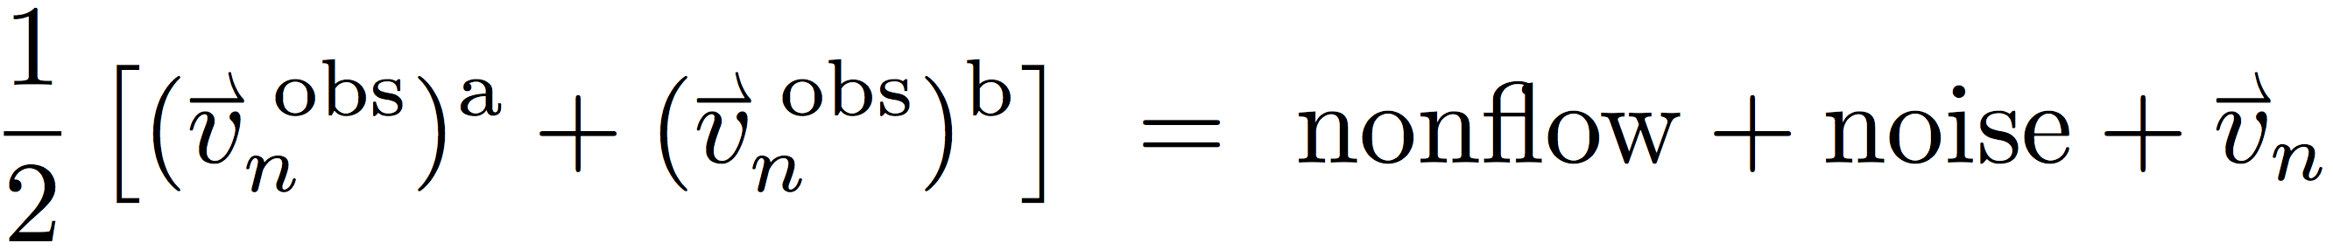
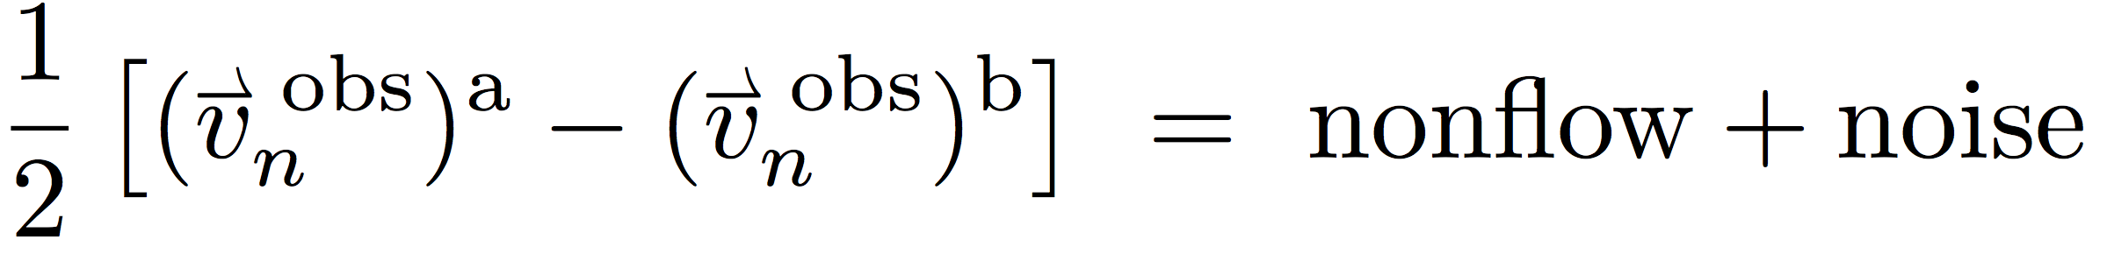
Split the event into two: 2SE method
Sub-event “A” vs. Sub-event “B”
Confirmed in simulation studies
arxiv:1304.1471
=
?

Slide 19
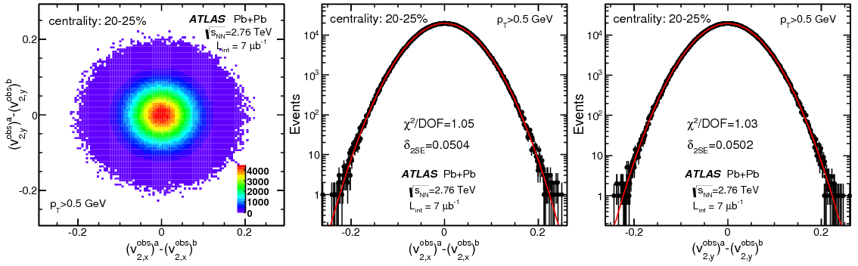
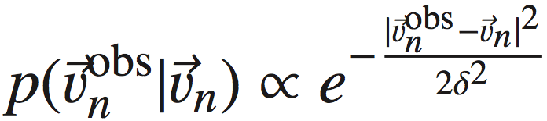


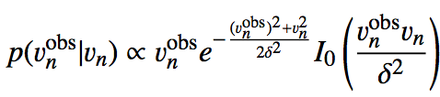
Obtaining the response function
nonflow + noise
Response function is a 2D Gaussian around truth
Nonflow is Gaussian!
Data driven method

Slide 20
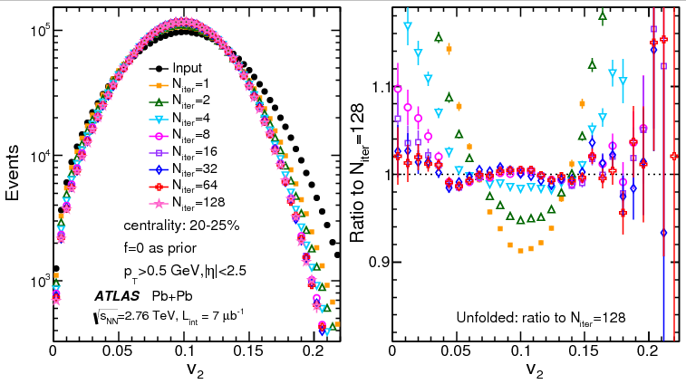
Unfolding performance: v₂, 20-25%
Standard Bayesian unfolding technique
Converges within a few % for N_{iter}=8, small improvements for larger N_{iter}.
Many cross checks show good consistency
  Unfolding with different initial distributions
  Unfolding using tracks in a smaller detector
  Unfolding based on the EbyE two-particle correlation.
  Closure test using HIJING+flow simulation
Details in arxiv:1305.2942
arxiv:1304.1471

Slide 21
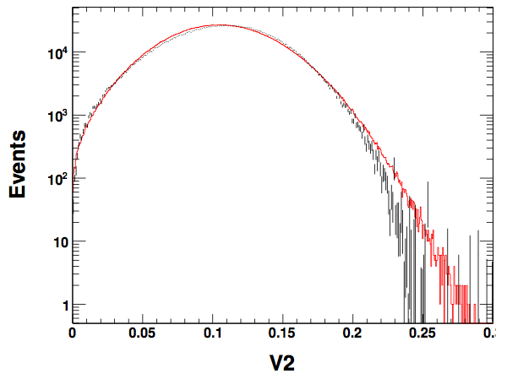
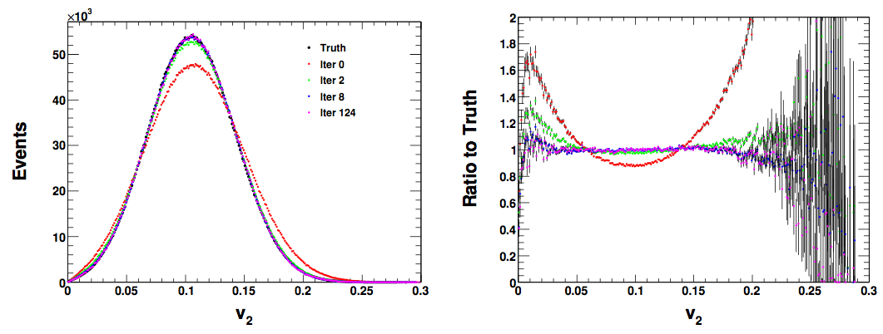
Monte Carlo test
Simulate the experimental multiplicity and v₂ distribution.
Determine the resp. func via 2SE method, and run unfolding.
The truth recovered!
truth v₂
data

Slide 22
p(v₂), p(v₃) and p(v₄) distributions
Measured in broad centrality over large v_{n} range
  The fraction of events in the tails is less than 0.2% for v₂ and v₃, and ~1-2% for v₄.

Slide 23




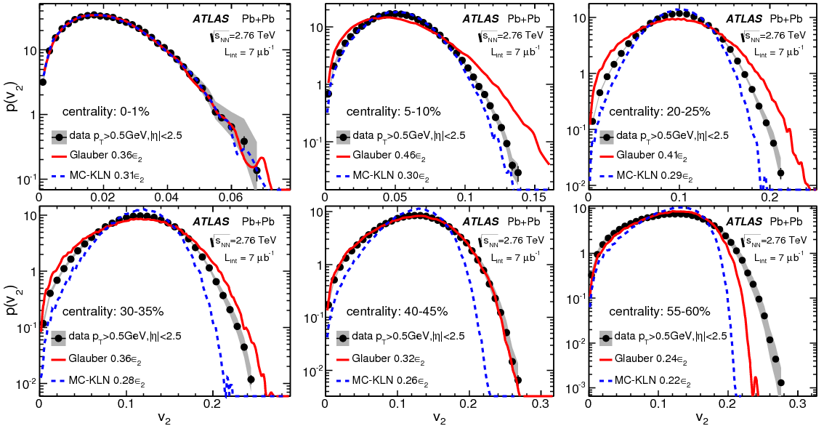
Compare with initial geometry models
Glauber and CGC mckln
  Rescale ε₂ distribution to the v₂ distribution
0-1%
5-10%
20-25%
30-35%
40-45%
55-60%
23
Both models fail describing p(v₂) across the full centrality range

Slide 24
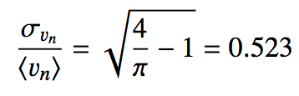
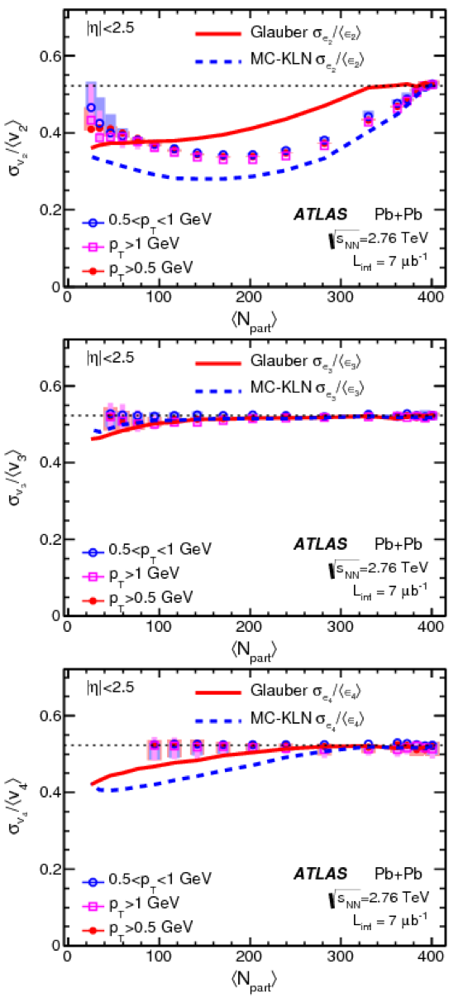
Compare with initial geometry models
Test relation
Both models failed.

Slide 25
p(v₂), p(v₃) and p(v₄) distributions
Parameterize with pure fluctuation scenario:
Only works in 0-2% centrality
Require non zero v₂^{RP} in others
Deviations in the tails:
non zero v₃^{RP}
No deviation is observed, however v₄ range is limited.

Slide 26
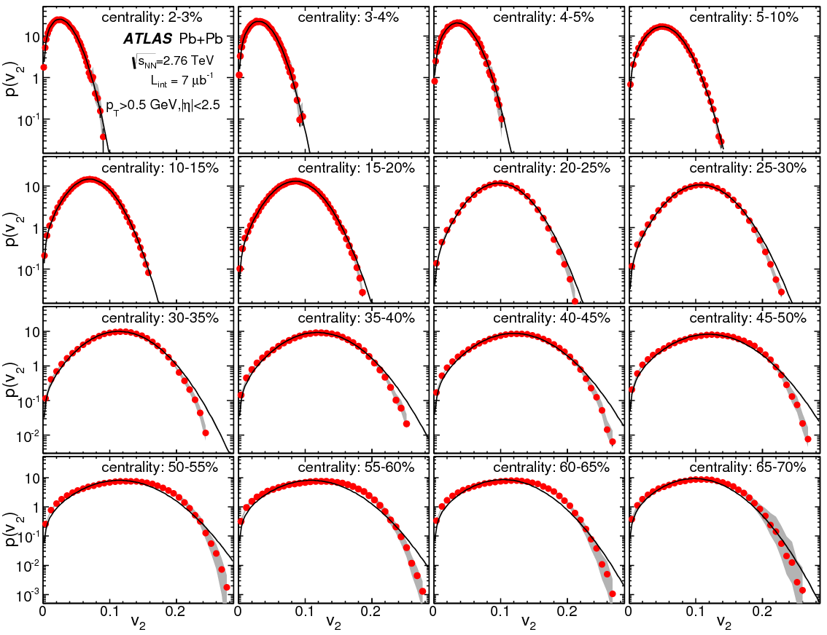
Bessel-Gaussian fit to p(v₂)

Slide 27
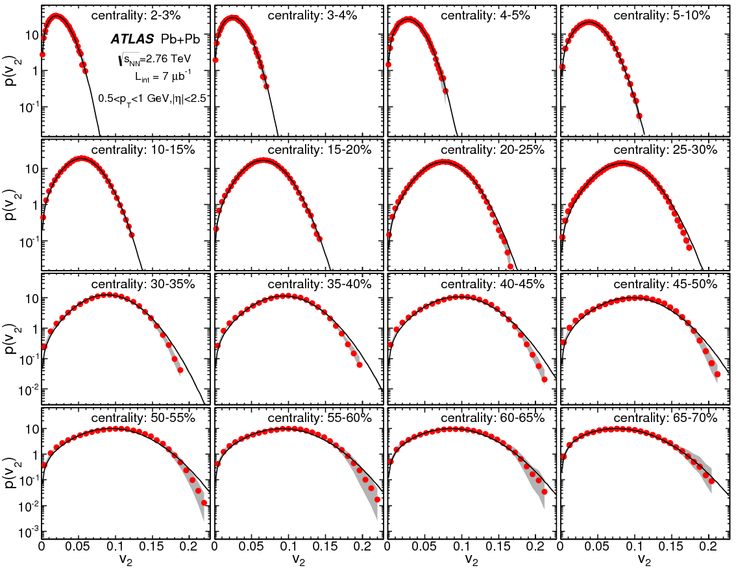
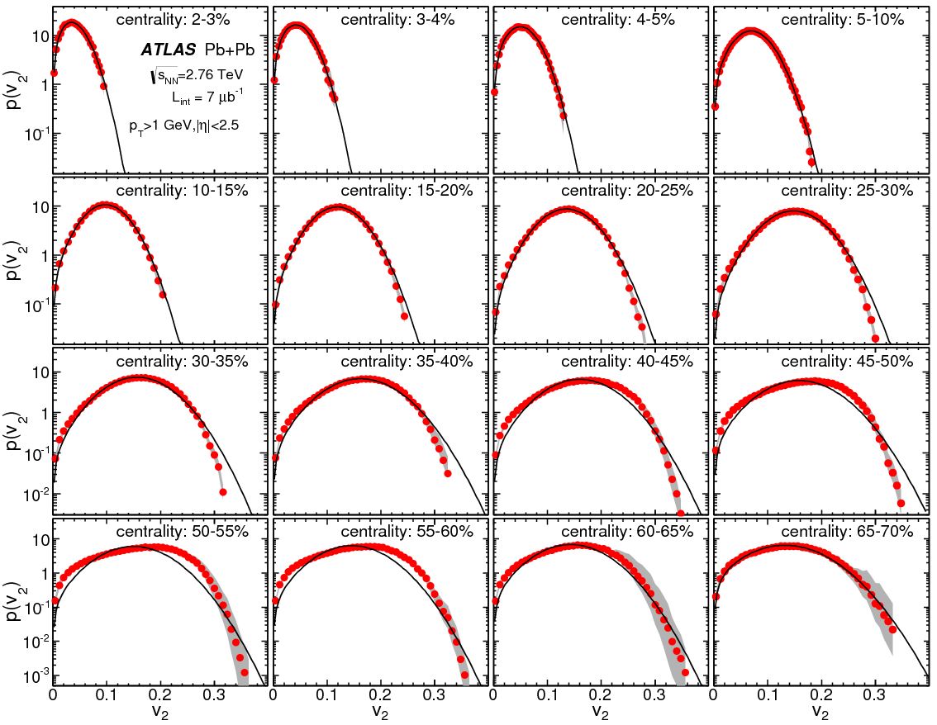
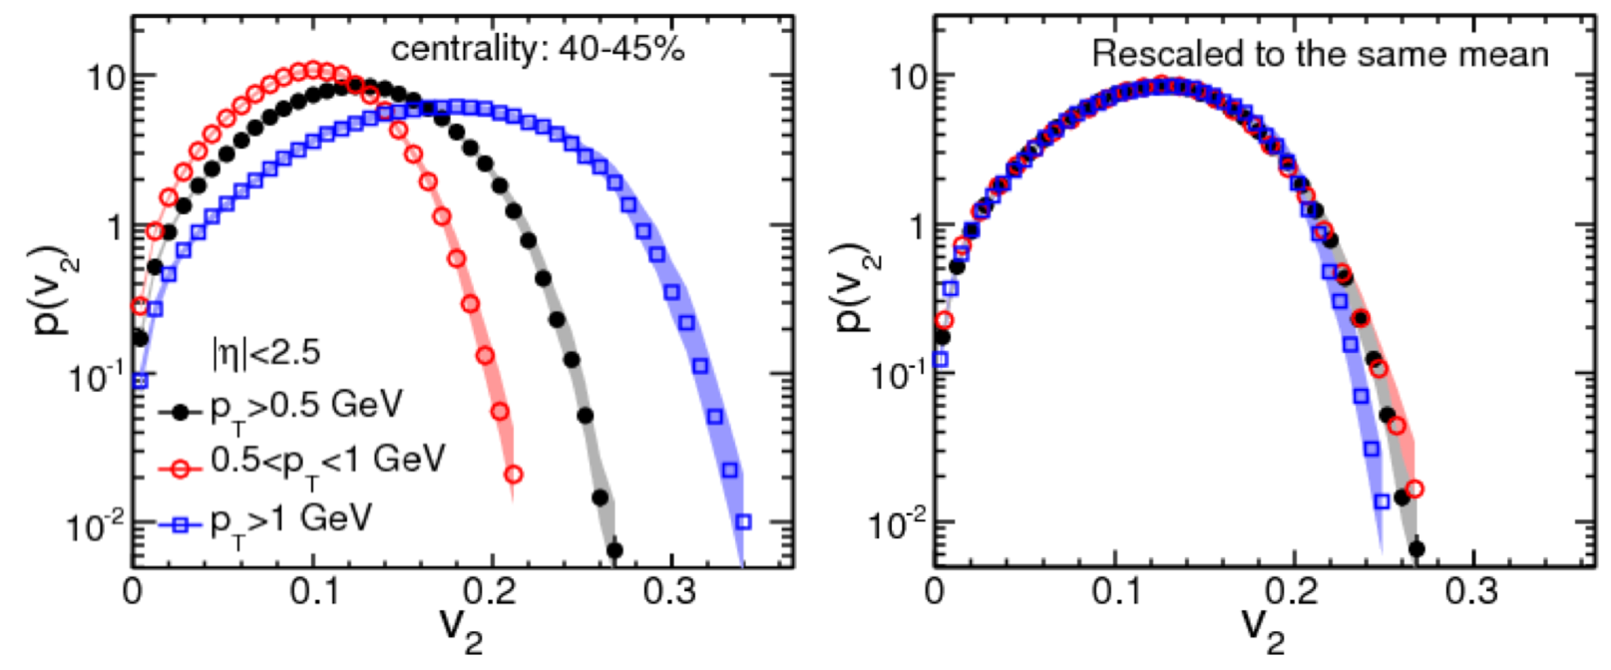
Deviation grows with p_{T}
p_{T}<1 GeV
p_{T}>1 GeV
Onset of non-linear effect!

Slide 28
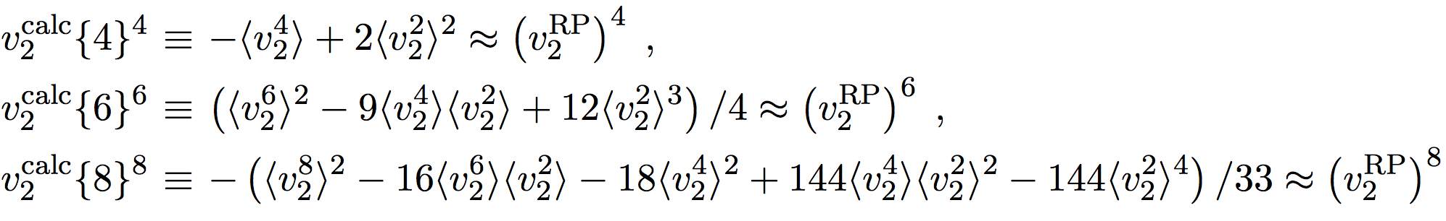
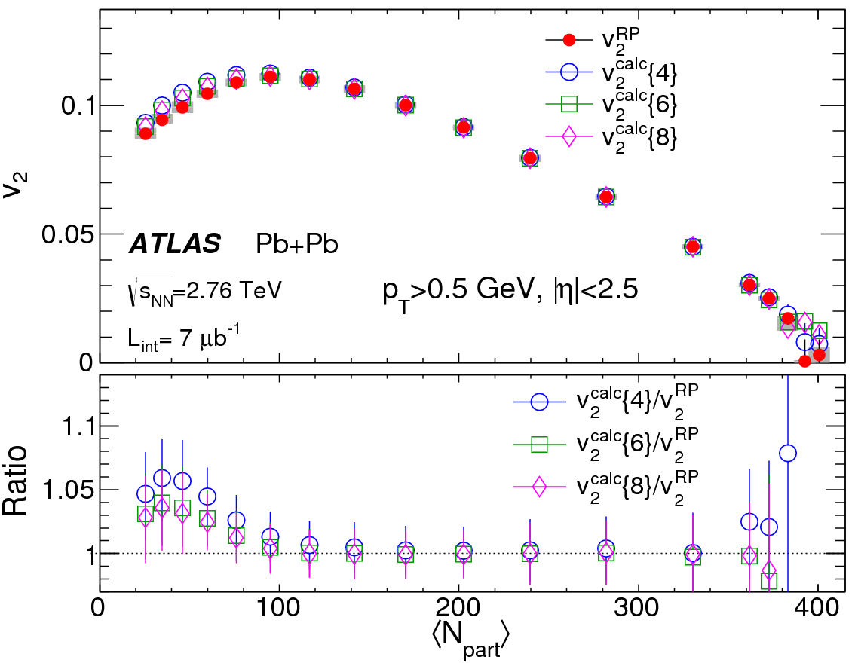
Are cumulants sensitive to these deviations?
Fit
Cumulants are not sensitive to the tails, presumably because their values are dominated by the v₂^{RP}:
If Δ=0.5 v₂^{RP}, v₂{6} only change by 2%

Slide 29
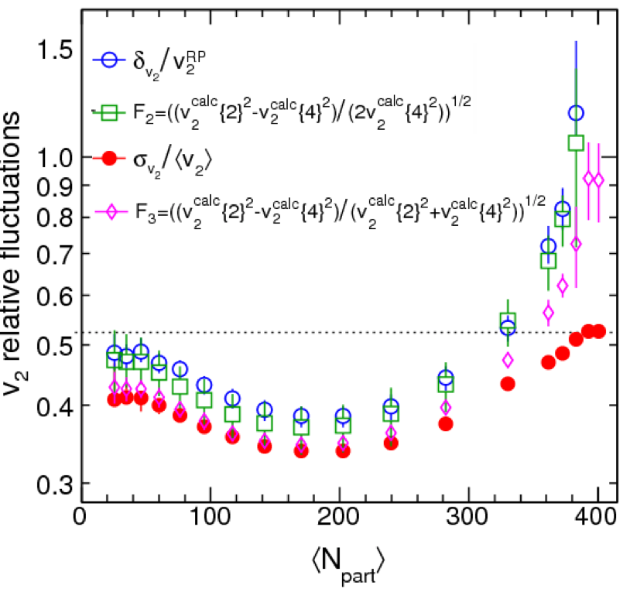
Extracting relative fluctuations
=
=
=
∞
1
=0.52
Fit
Different estimator gives different answer, especially in central collisions
  Expected since they have different limit.

Slide 30
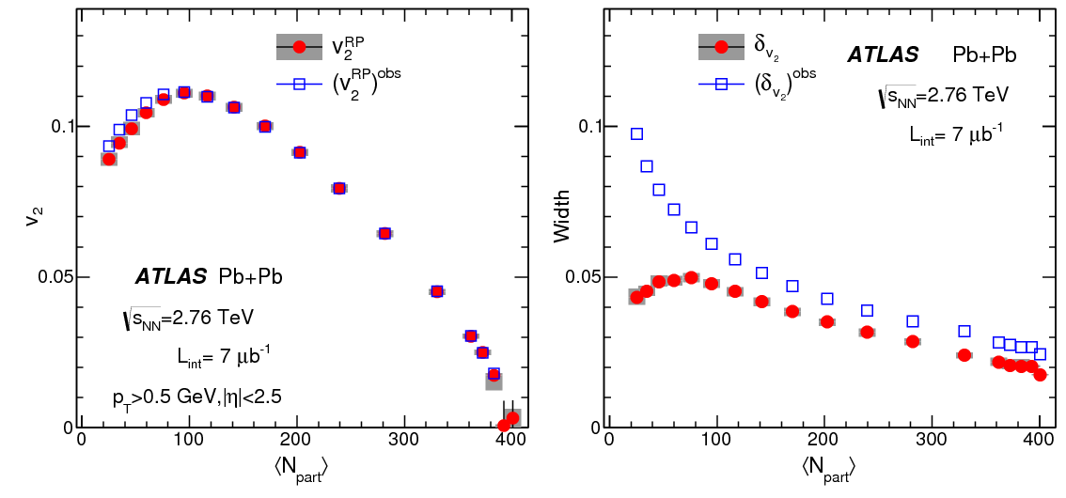
v₂^{RP} without unfolding
Removed by unfolding
Initial geometry fluctuations
Additional Gaussian smearing won’t change the v₂^{RP}.
Response function (nonflow+noise) is no longer Gaussian
The meaning of v₂{4} is non-trivial in this limit (also in pPb)
Notes:
Nonflow is guassian
Provide a economical way of calculating v2RP.

Slide 31
Flow fluctuation & v₃{4}
v₃
Even a small deviation will imply a v_{n}^{RP} or v_{n}{4} value comparable to δ_{vn}
a 4% difference gives a v_{n}{4} value of about 45% of v_{n}{2}

Slide 32
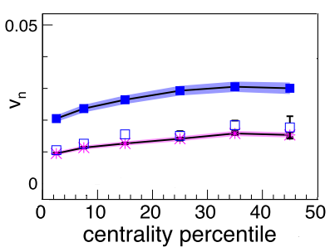
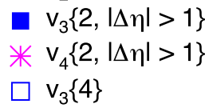
Flow fluctuation & v₃{4}
v₃
Even a small deviation will imply a v_{n}^{RP} or v_{n}{4} value comparable to δ_{vn}
v₃{4} /v₃{2}~0.5 or
v₃^{RP}~0.8 δ_{v3}
a 4% difference gives a v_{n}{4} value of about 45% of v_{n}{2}
Due to a non-Gaussian tail in the p(v₃) distribution?.
ALICE

Slide 33
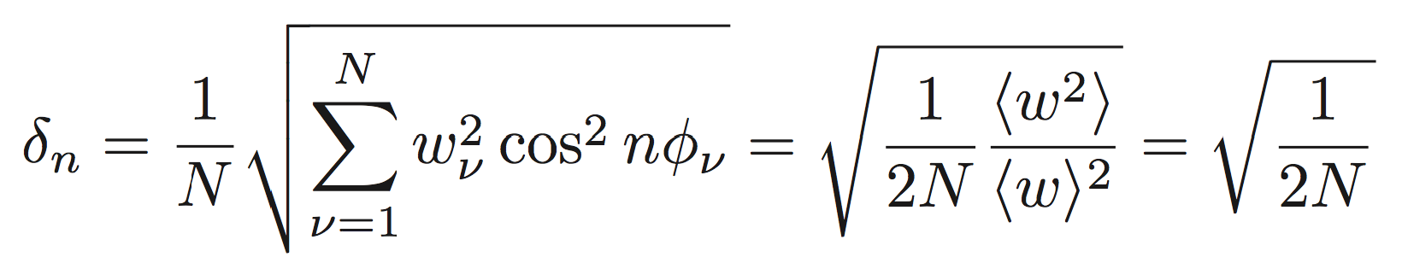
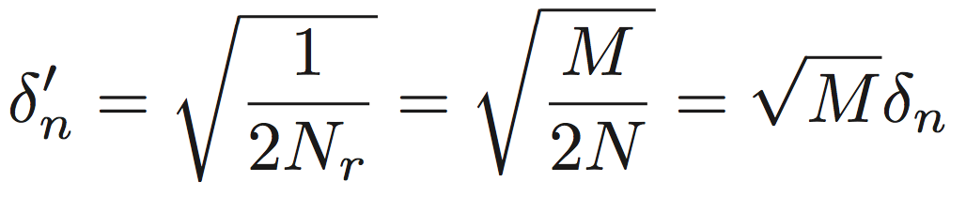

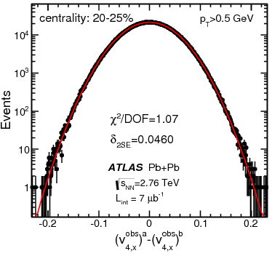
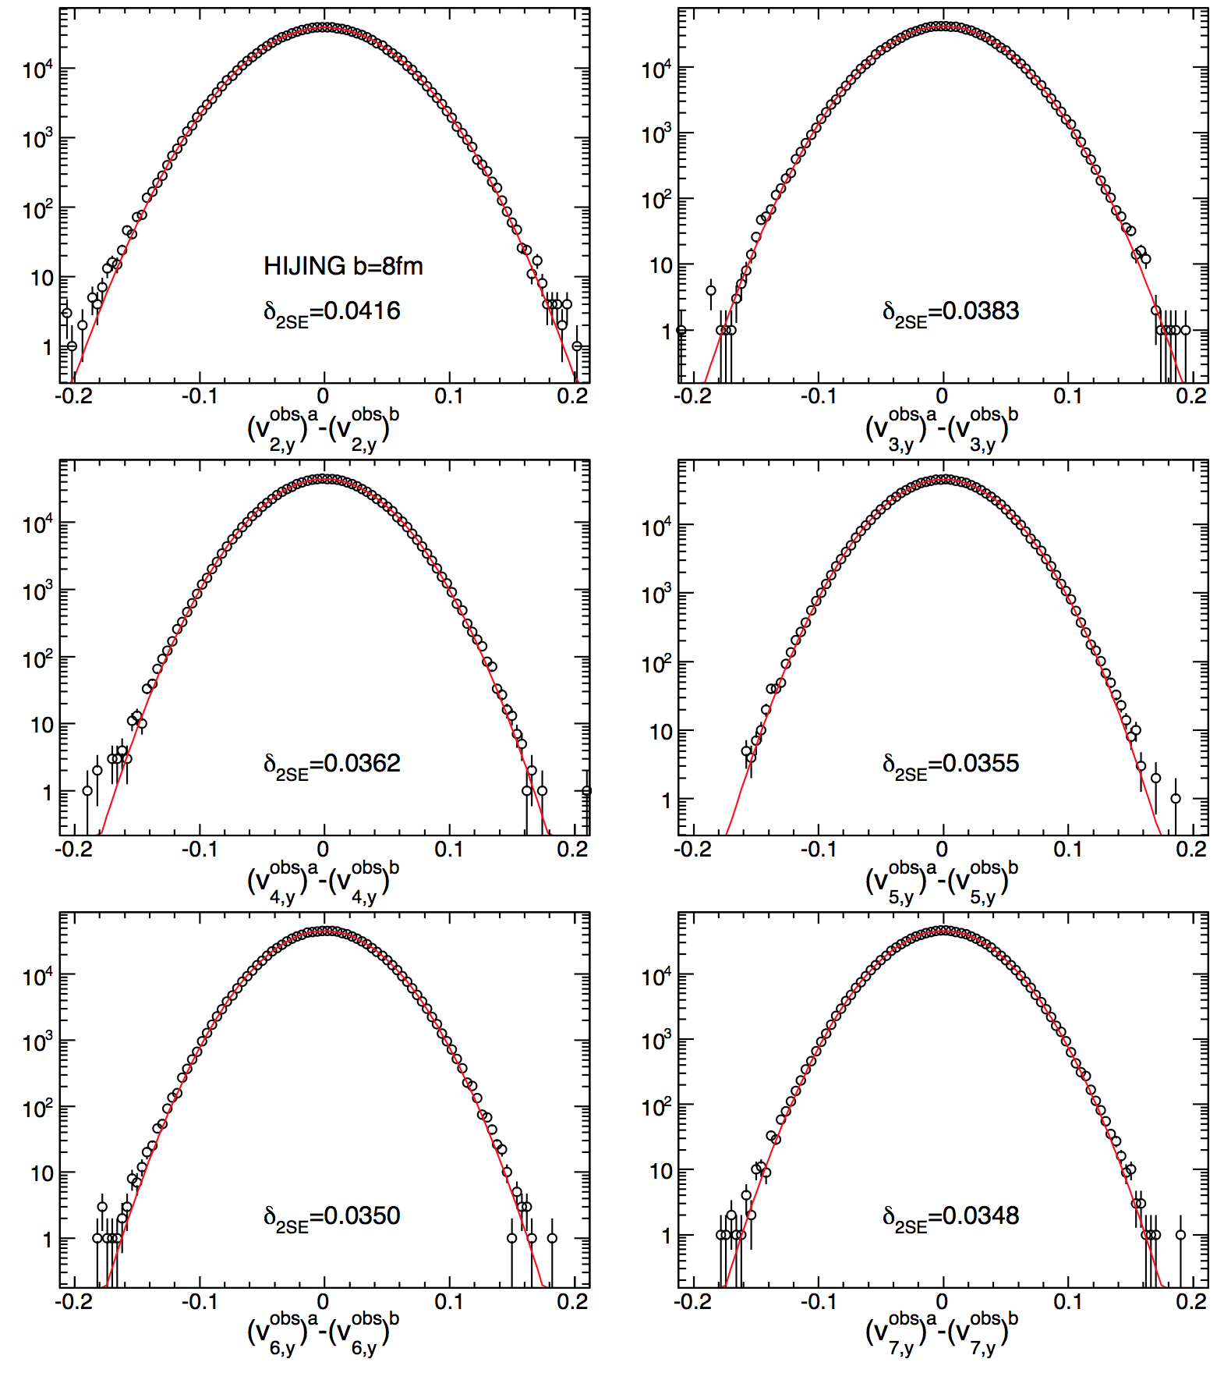
Nonflow to response function in HIJING
Width = statistical + non-flow
Correlated sources typically increase the width, e.g. N_{r} resonances, each produce M particles
n=2
n=3
n=4
Data
n=2
n=3
n=4
HIJING
Notes:
Also true for jets

Slide 34
Resp function: HIJING w/o flow
n=3
n=2
arxiv:1304.1471
Short-range correlations can be removed by the 2SE method, small residual for v₂.
The residual non-flow effects can be obtained by unfolding the v₂^{obs} distribution which is largely Gaussian
distribution of non-flow is Gaussian!

Slide 35
HIJING with flow afterburner 20-25% (b=8fm)
Compare the unfolded result to the Truth distribution.
The unfolding converges, but to a value that is slightly different from truth→ because the response function ≠ v_{n}^{obs} without flow.
Notes:
Checked the final answer of vn has very little cross talks. Independent whether use fixed vn or pT dependent vn. Response function identical

Slide 36
Summary of impact on the mean and width
Most of non-flow is suppressed. Residual non-flow (few %) is a simultaneous change of mean and width, so do not affect the shape.
Notes:
(since it is mostly additional Gaussian smearing)

Slide 37
Summary
Event-by-event fluctuation of the QGP and its evolution can be accessed via p(v_{n},v_{m},….,Φ_{n},Φ_{m}…..)
Detailed correlation measurement 2- and 3- event planes → the Fourier coefficients of p(Φ_{n},Φ_{m}) and p(Φ_{n},Φ_{m,}Φ_{L})
  Strong proof of mode-mixing/non-linear effects of the hydro response to initial geometry fluctuations.
  New set of constraints on geometry models and η/s.
First measurements of the p(v₂), p(v₃) and p(v₄)
  Strong constraints on geometry models.
  p(v₂) show significant deviation of the fluctuation from Gaussian, also suggestive of strong non-linear effects.
  v₂{4,6,8} are not sensitive to these deviations, except in peripheral collisions.
  p(v₃) distribution suggests a non-zero v₃^{RP}.
  HIJING simulation show unfolding is robust for suppressing the non-flow contribution.
Look into other correlations.

